Slide 1
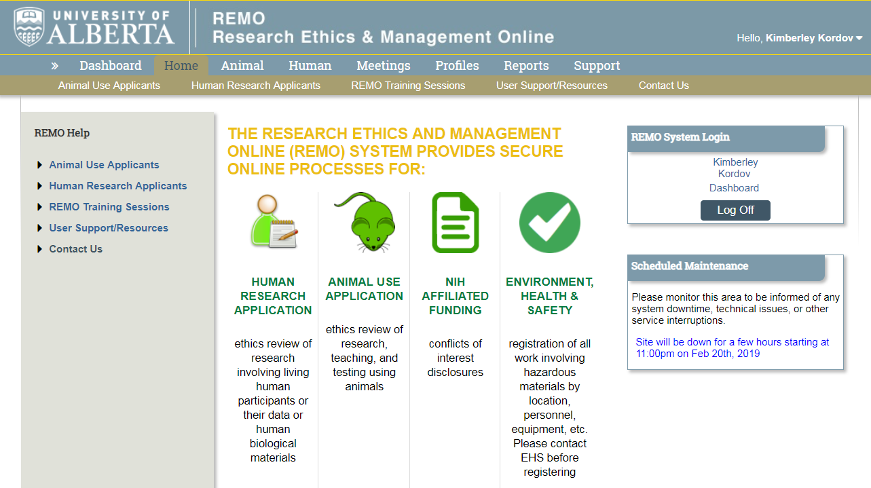
Alberta Research Information Services (ARISE)
Getting Started

Slide 2
Online Ethics Application System - Technical
https://arise.ualberta.ca
OR
link from Research Ethics Office website (https://www.ualberta.ca/research/support/ethics-office)
Browsers: Google Chrome is preferred browser, Safari is not compatible with ARISE.
You MUST disengage your pop-up blocker.

Slide 3
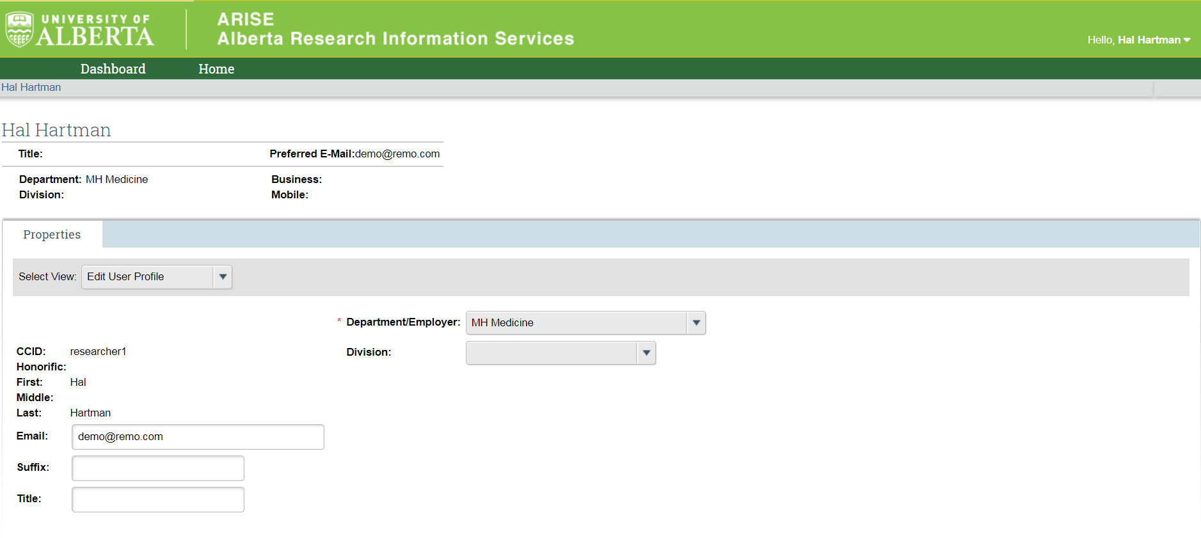
Getting Started….
Faculty Members
Complete CCID request form
Log into ARISE:
Select REB Principal Investigator AND REB Faculty Supervisor
MUST identify department as University of Lethbridge (Department)
Be sure to click SUBMIT REQUEST
https://www.youtube.com/watch?v=Cm0nUUtBdAs

Slide 4
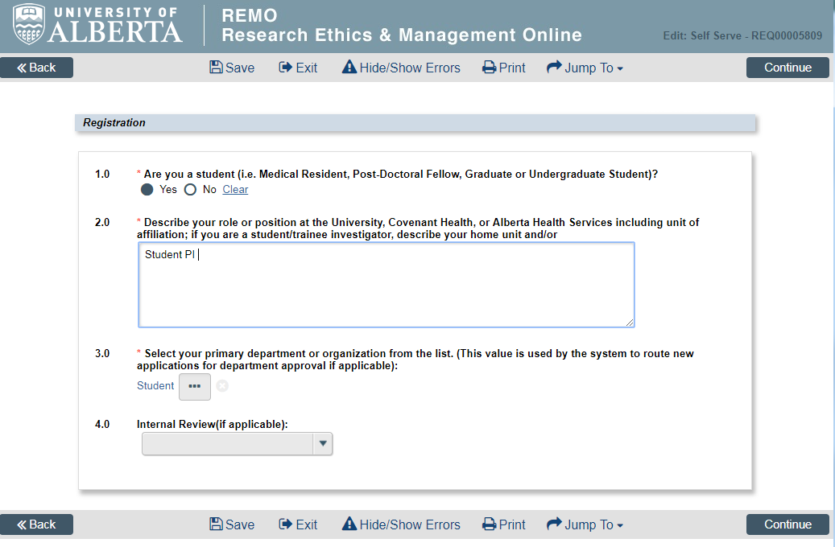
Getting Started….Students/Learners/Trainees
Log in using CCID/password
Click
Select REB Principal/Co-Investigator.
Answer 4 questions:
1.0 YES
2.0 Describe your role
3.0 Department = STUDENT
4.0 Leave blank
Click
Click

Slide 5
Getting Started….Study Coordinator/RA
Log in using CCID/password – logging into the system should allow your name to display in the drop down in ARISE 1.1 (8.0)
Set your Department by clicking My Profile (top right corner)
With Study Coordinator role you can:
View and edit the application, and receive notifications regarding it once you are listed as the study coordinator on the application.
Start a new application on behalf of a PI and be listed on a new ethics application as study coordinator
Be listed on an existing application(s) by using the "Change Personnel" function in the application. If needed, see “Change Personnel” to add/delete/change personnel.
Troubleshooting – click here

Slide 6
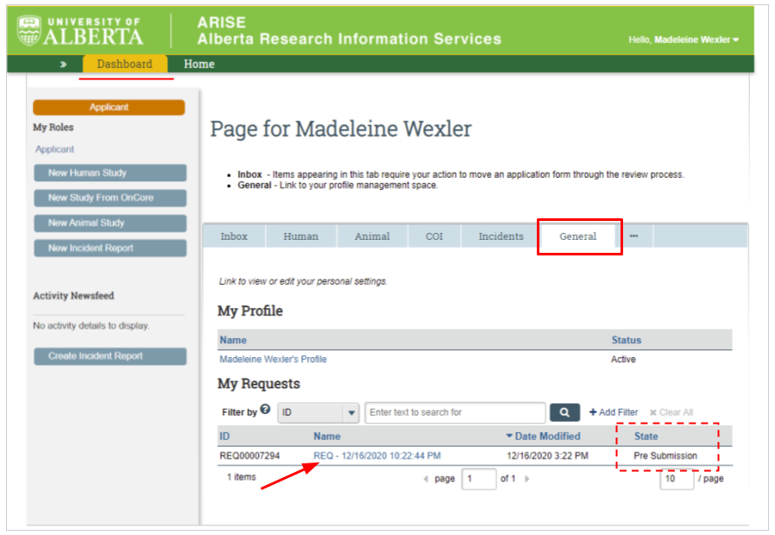
ROLE REQUESTS….
What can go wrong?
You did not submit the request
No Human Tab
No Request Additional Role Button

Slide 7
Research Ethics Boards
REB 1 - Research that primarily involves in-person interviews, focus groups, ethnographies, or community engagement and instructor-led course-based research assignments
REB 2 - Research that involves interventions (socio-behavioural, educational) or research that primarily concerns privacy, data-sharing, confidentiality, questionnaires, survey methods and internet research. Mixed methods (ie. interviews and surveys will come here).
REB 3 - Health Panel – non-invasive interventions, using patients/health information of patients in Health Care system (ie. surveys, questionnaires, interviews, psychological, social or behavioral interventions, educational strategies, chart and record reviews)
REB 4 - Biomedical Panel - invasive interventions, e.g. administration of drugs, surgical procedures (including biopsies), collection of blood or other biological specimens

Slide 8
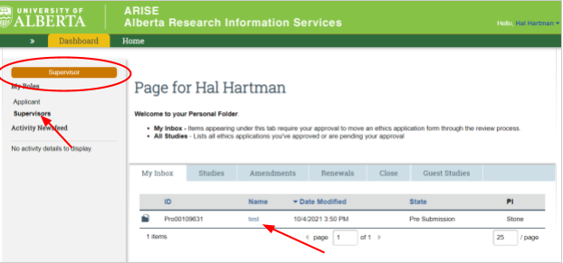
Student & Trainee Research – REB 1 & 2
The student is the PI. You must set your profile correctly.
Supervisor can view and edit in their Supervisor ROLE.
Both the PI and the Supervisor receive automated system email notifications.
Click here for HELP DOCUMENT -
Supervisor Review

Slide 9
Student & Trainee Research - HREB REB 3/4
The student is the Co-Investigator.
The Academic Supervisor is the PI.
All Student/Learner/Trainees (ie. Post-Doc, Medical Resident, PhD, and Masters students) are considered students and cannot be the PI for HREB applications.
Co-Investigator can create application.
PI must submit the first time the application is submitted.

Slide 10
Who can access/submit a study?
View/Edit Access:
Principal Investigator
Co-investigator
Study Coordinator
Supervisor
Submit:
Only the PI can submit the study the first time.
Post-submission: the PI, Co-Is and Study Coordinators can respond to requests for changes, and submit amendments and renewals.
Supervisor can Change personnel and Change funding but cannot create amendments or renewals.

Slide 11
Email Notifications….they are important!
Automated system notifications:
Initial submission, Change requests from reviewers / supervisors, REB decision, Renewal reminders, Approval
IMPORTANT:
Automated system notifications go to @ualberta.ca email addresses; however, you can re-direct to a different email address.
Log into ARISE.
Click on your name (top right corner of the screen).
Click on My Profile.
Click on Edit My Info (on the left side of the screen).
Enter your preferred email address in the Email field.
Click OK to submit the change and exit the form.

Slide 12
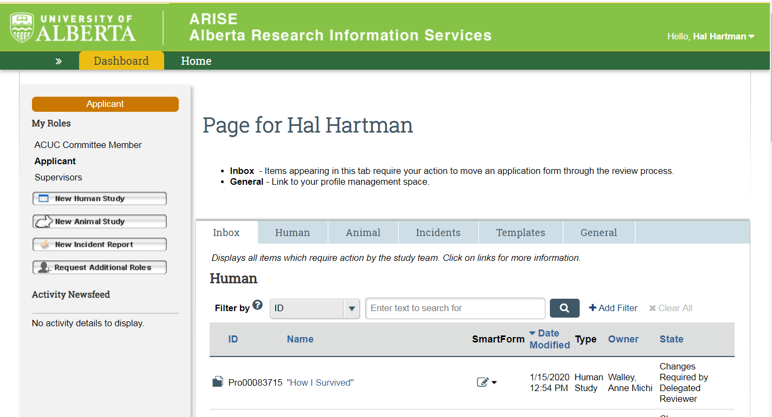
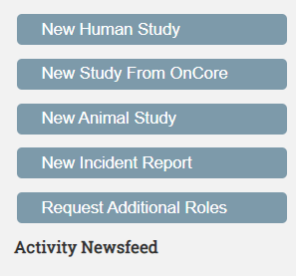
Your Dashboard

Slide 13
Your Roles – Make sure you are in the right one

Slide 14
Start a New Study
Click to watch video here on how to create a new study

Slide 15
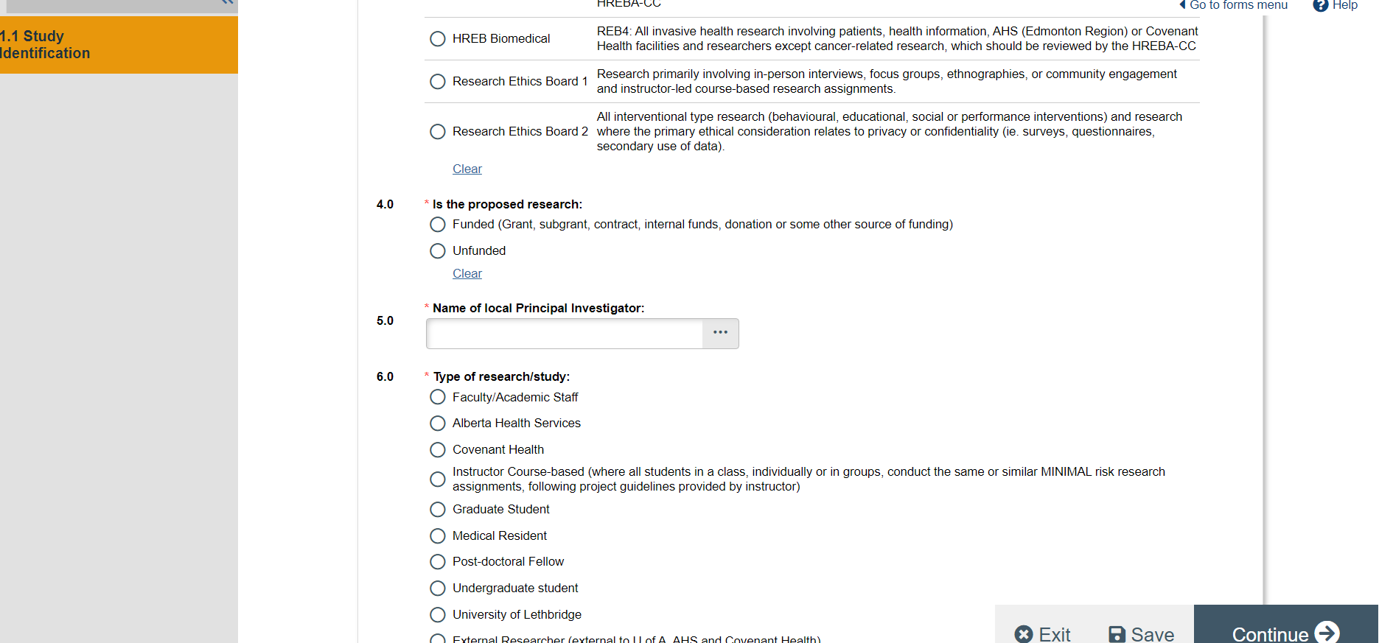
New Study Application – Indicate your affiliation

Slide 16
Your Inbox
If a study is here – it is with YOU to edit and/or make a change

Slide 17
Access all your studies
If you need to create new AMENDMENT or RENEWAL, you will find your approved study here.

Slide 18
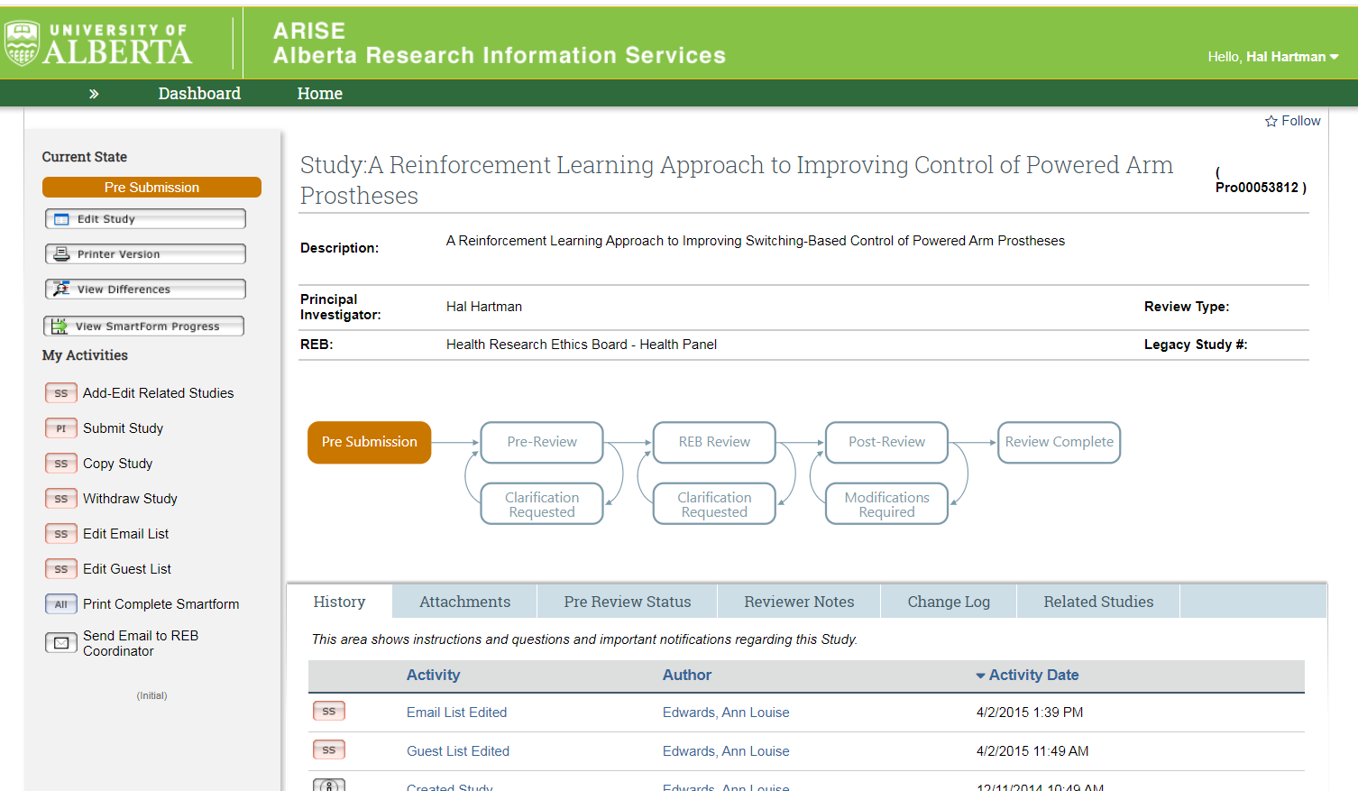
Study Workspace

Slide 19
Study States – what’s going on with my study?

Slide 20
Study Workspace – Access your application
Click here to open up the study to edit. If it says View Study, you cannot edit it.

Slide 21
Study Workspace – My Activities

Slide 22
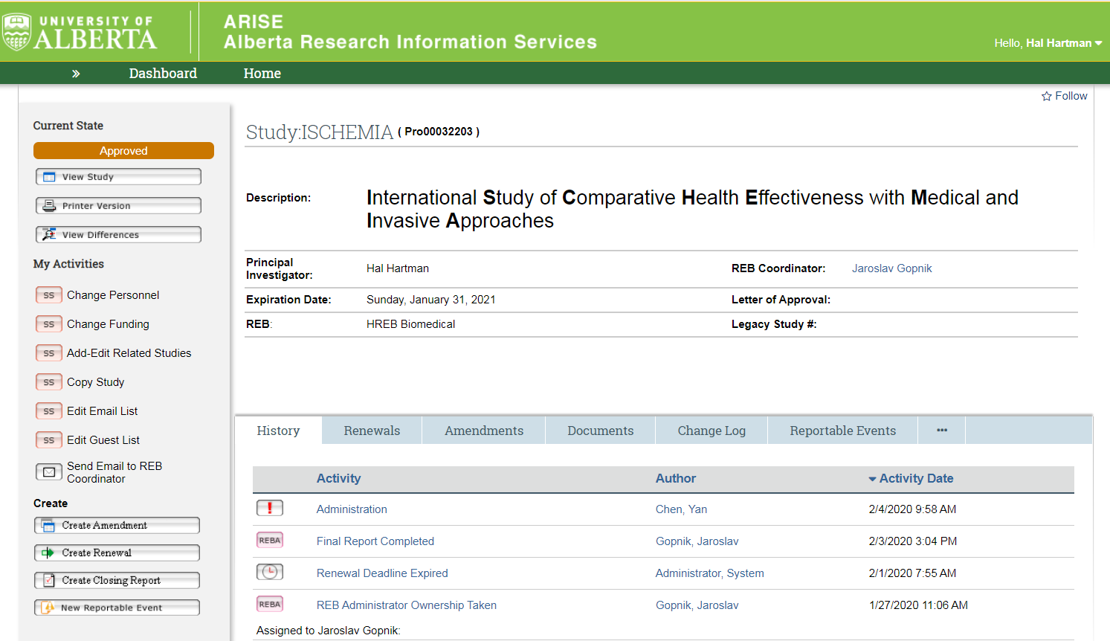
Study Workspace – Study Identification

Slide 23
Study Workspace – REB Administrator

Slide 24
Study Workspace – History

Slide 25
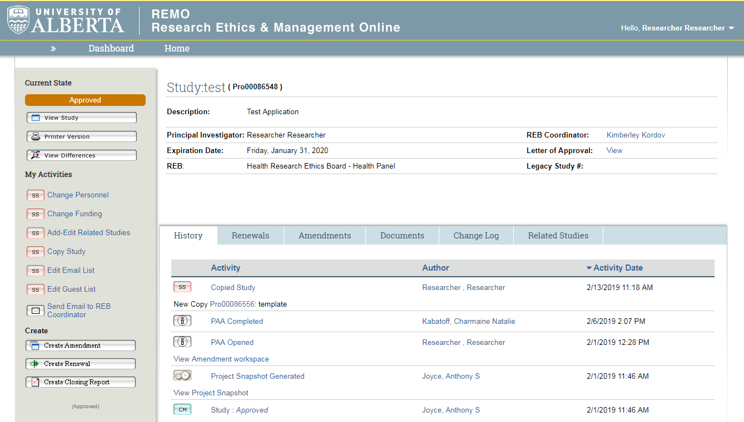
Study Workspace – Approval Letter
Shows you the first approval letter

Slide 26
After Approval – Post Approval Activity (PAA)
Approval for 364 days, if study still active must renew.
System will prompt with emails at 30,15 and 10 days (to @ualberta.ca)
ANY changes to approved research require REB review BEFORE they are implemented.

Slide 27
Migrating Your Study Into ARISE….
Create a NEW STUDY

Slide 28
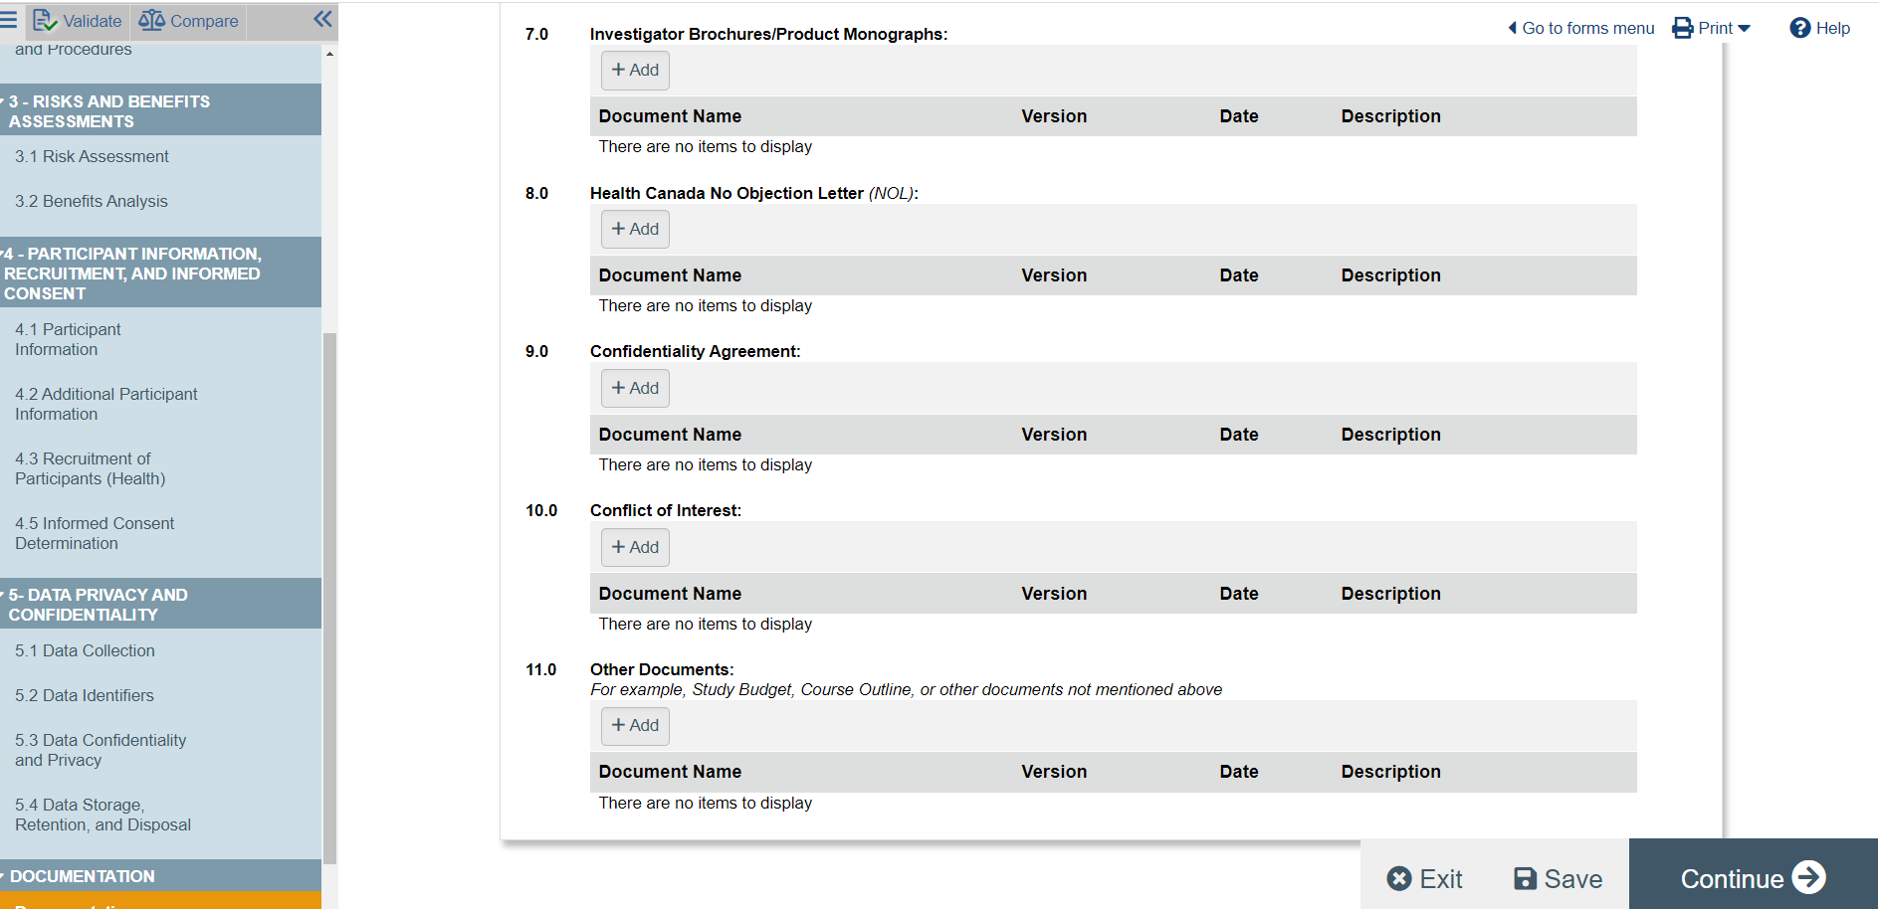
Migrating Your Study Into ARISE….
Upload:
Approval certificate
Approved application
Amendment or Renewal FORM (fillable .PDF)
Complete application with APPROVED application text (and/or things that have changed because of amendment).

Slide 29
Migrating Your Study Into ARISE….
Do NOT create a new study for a renewal and a new study for an Amendment
Can complete a Renewal and Amendment AT THE SAME TIME (only this once)
After initial approval - amendments and renewals cannot be done together

Slide 30
AFTER MIGRATING INTO THE SYSTEM - Create Amendment/Renewal
Remember: Approved studies will be found in the “human” not Inbox tab

Slide 31
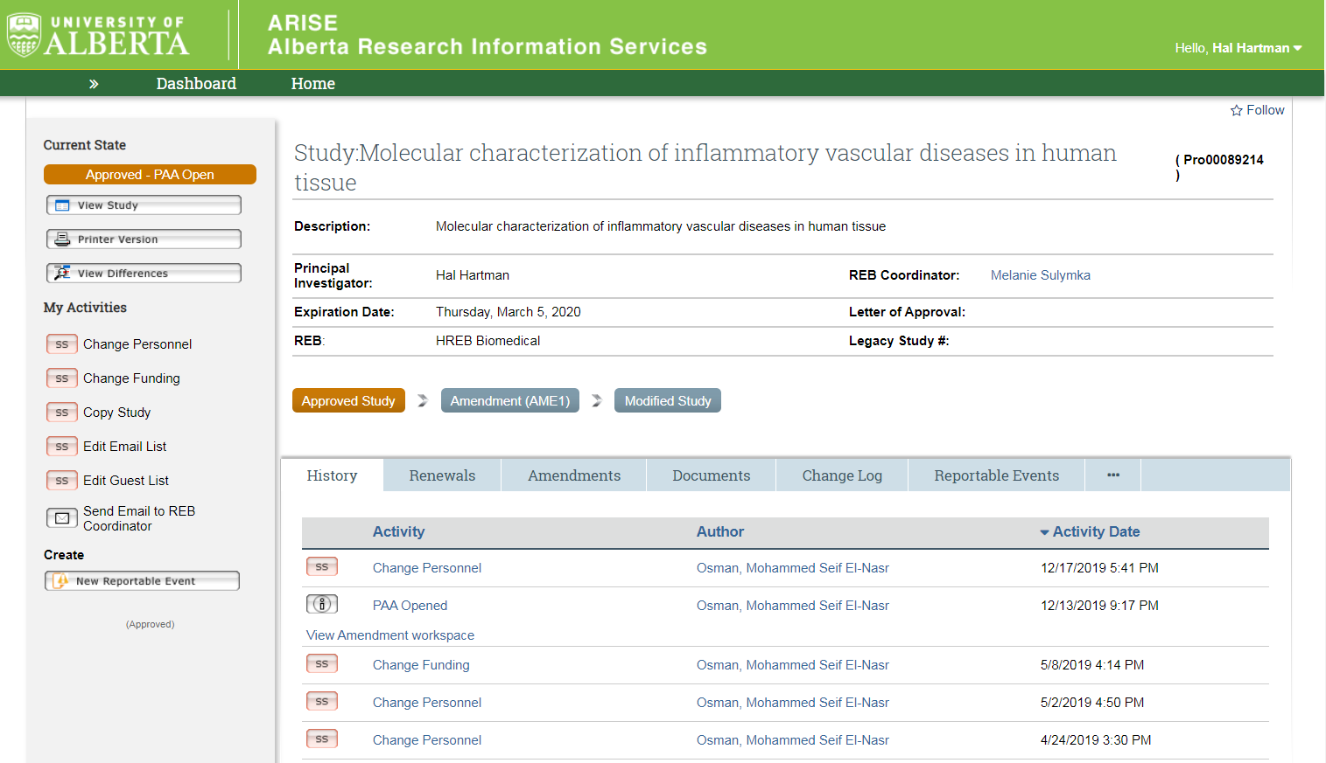
Study Workspace – Access Amendment/Renewal

Slide 32
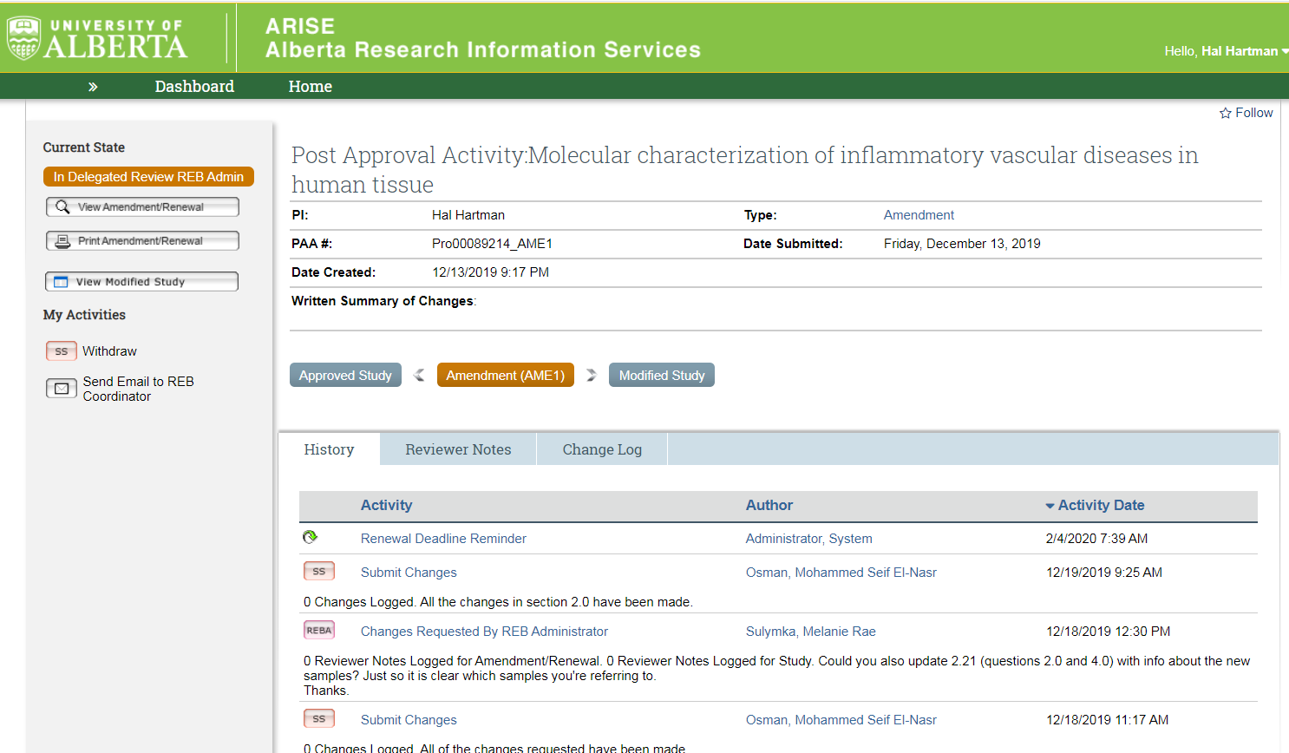
Amendment/Renewal Workspace
The orange shading shows you where you are in the study

Slide 33
Modified Study Workspace

Slide 34
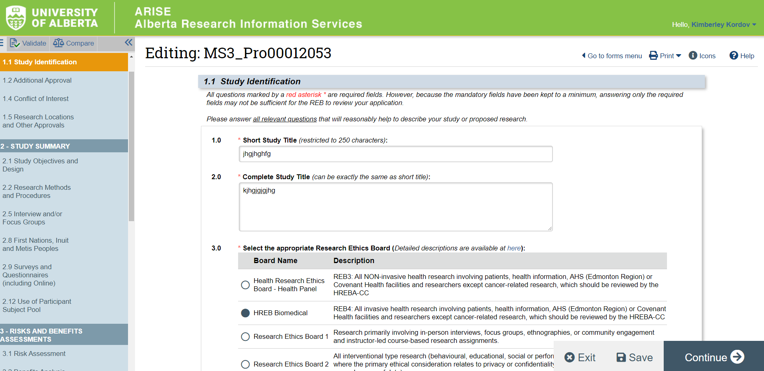
Modified Study Workspace
Editable copy of your approved study. Ensure all changes are reflected here.

Slide 35
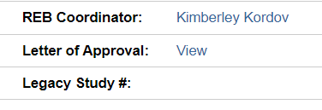
Renewal/Amendment Workspace – Approval Letter
Shows you the amendment/renewal specific approval letter

Slide 36
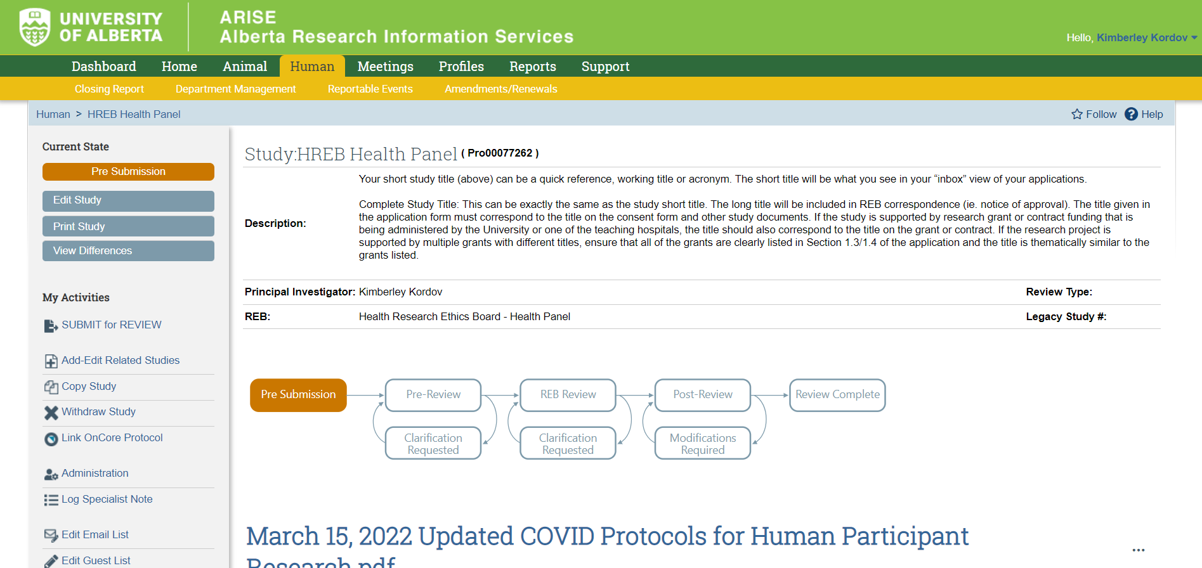
How to SUBMIT

Slide 37
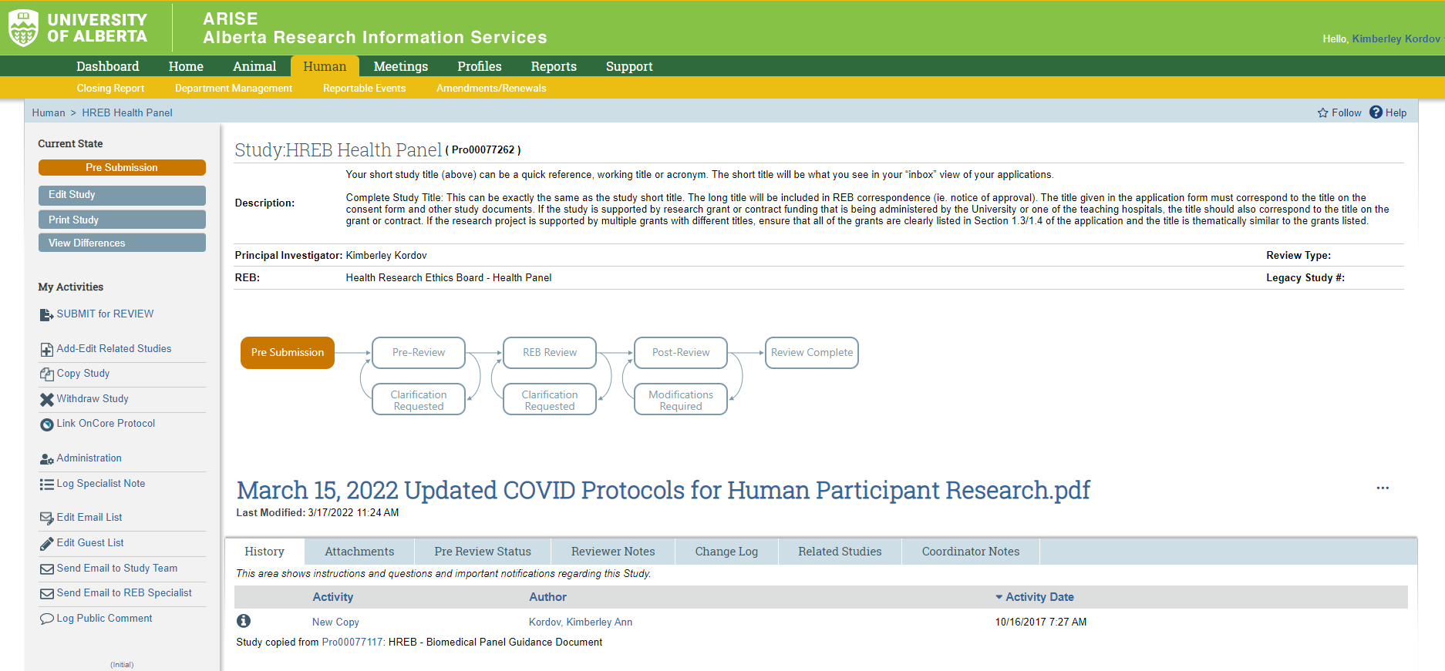
SUBMIT versus EMAIL to REB Coordinator
Do NOT use this to respond to requests for clarification/change

Slide 38
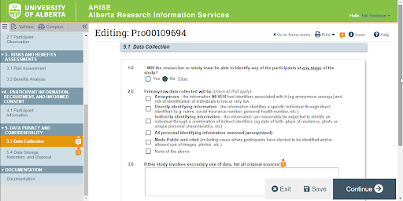
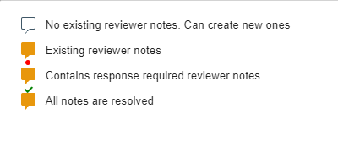
Reviewer Notes: REB Requests for changes
Important to know:
REB Staff or REB Reviewer request for changes
Applied to a specific question
May be required to provide a response
Answer the reviewer note AND change the question it is applied to

Slide 39
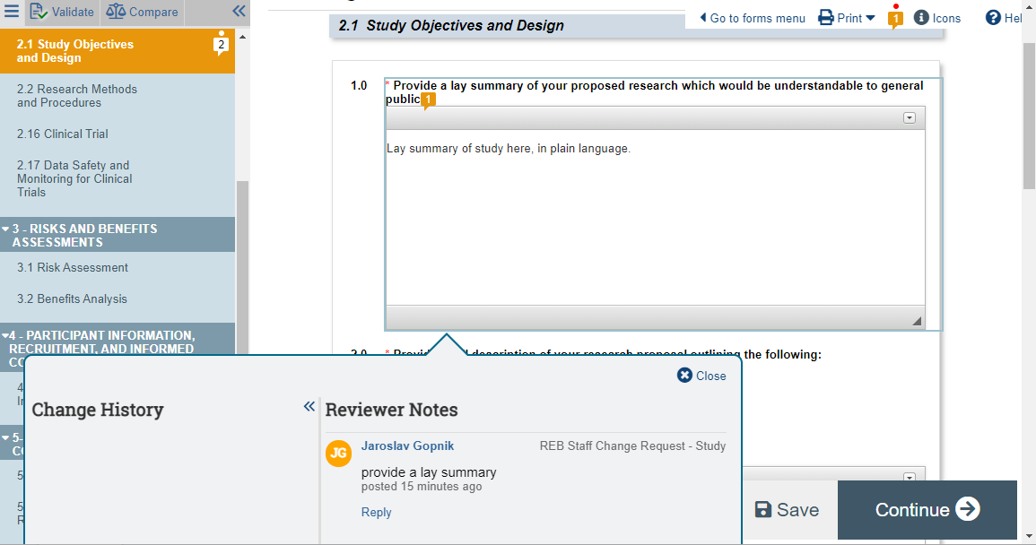
Reviewer Notes: REB Requests for changes

Slide 40
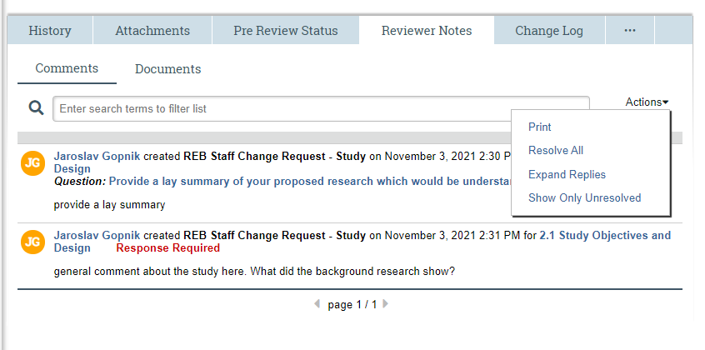
Reviewer Notes: REB Requests for changes
Can’t submit the study? Check this……

Slide 41
Important Take Away….
Request Additional Role - Make sure to submit the request
Notifications are important - forward to your U of L email
Make sure you are working in your correct ROLE
Approved studies are in the HUMAN tab (not INBOX)
Always Submit for REB review - instead of Send Email to REB Coordinator
When coming into the system for the first time, AME and REN can be submitted together using uploaded forms
After initial approval AME and REN must be submitted ONE AT A TIME - using the Create functionality (ie. not uploading a paper form)
Use the ARISE help resources
and finally…………

Slide 42
ARISE Help & Video Tutorials Create an amendment Create a renewal Respond to reviewer notes

Slide 43
Website: https://www.ualberta.ca/research/support/ethics-office
Alberta Research Information Services Online System (ARISE)
https//:arise.ualberta.ca

