Slide 1
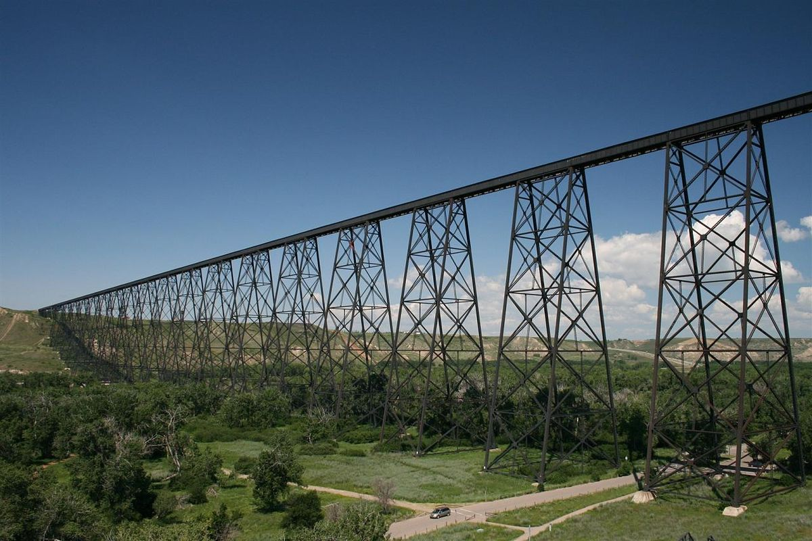
Therapeutic Recreation Internship (TREC 4550)
Thursday January 27th, 2022
Aimee Douziech, Marina Christman, & Zac Crouse

Slide 2

Agenda
Course requirements
Internship Overview & Requirements
Overview of Placement Process
International Placements
Your Responsibilities / Required Documents
Course Text / Manual
COVID-19
Additional Information
Next Steps and Next Meeting
Q & A

Slide 3
TREC 4550 Course Requirements
TREC 4550 is the cumulative course in the TR program. Students must complete all 15 courses of the program (TREC, support courses, and electives) before enrolling in the practicum and meet the minimum GPA requirement.
Review your Program Planning Guide to ensure you will meet course requirements. Contact your academic advisor Tara Froehlich regarding your course sequencing if you are unsure if you meet the requirements.

Slide 4
Internship Dates
Fall 2022 internship
  September 6th 2022 – December 16th 2022 (15 weeks)
Spring 2023 internship
  January 3rd 2022 – April 14th 2022 (15 weeks)

Slide 5
Internship Hours
15 consecutive weeks
560 hours minimum
Full-time hours are expected (between 37.5 to 40 hours a week)
No more than 45 hours per week

Slide 6
Supervisor Requirements
The internship must be supervised by an academic supervisor (i.e., your instructor) and an agency/site supervisor, both of whom need to be a current/active CTRS.
The agency/site supervisor must be certified for at least one year prior to supervising students.
The agency/site supervisor must work fulltime hours (or close to this) at the agency, with at least 50% of their job duties within therapeutic recreation services
  *There may be a couple pre-approved situational variations to this requirement—these will be shared with you if / when relevant

Slide 7
One Site
Must have 1 primary agency/site supervisor.
The experience must take place at one agency site
  The total hours may not be split among different agencies or accumulated over multiple sites, unless the site is within the same agency, and under the direct supervisor of the CTRS.
*There may be a couple pre-approved situational variations to this requirement—these will be shared with you if / when relevant

Slide 8
Placement Process
Important notes on Agencies / Supervisors
Private Agencies
Larger Health Organizations

Slide 9
Important notes on Agencies/Supervisors
We have several affiliation agreements with a variety of agencies across Canada. In order to complete the internship at an agency, an affiliation agreement must be signed before day 1.
The University of Lethbridge has a database of previous supervisors, however, not all will be available for the time you are requesting.
  We aim to provide you with a list of potential sites approximately 5 months before the start of the term. This list is not all-encompassing.
From the pre-internship survey, we can try to assist in the planning process with you. Ultimately you are responsible to determine where you want to be placed and the type of experience you want – this process is student directed.

Slide 10
Private Agencies
  View agency website to find more information (Follow the instructions on their website for the application process, if no instructions you are likely fine to reach out to them directly with your inquiry)
  When reaching out it’s helpful to provide information on the placement (such as the hours, CTRS requirements, etc.)
  Be prepared to interview for the placement (make sure the agency and supervisor is a good fit for you!)
  If it seems to be a good fit or if you are offered placement – contact Marina to start the administrative pieces and get affiliation agreement in place.
  Determine the agency’s placement requirements and get started on meeting them.

Slide 11
Agencies like AHS, Covenant, VCH, NSHA… etc.
Certain agencies require Institutions (UofL) to follow specific application processes and deadlines for student placements
Students CANNOT initiate contact with a potential preceptor at these (and other) agencies, if your unsure of the agency’s policy contact Marina for assistance
Application Deadlines are typically 4 months before intended placement term, for example (other agencies could have other deadlines):
  AHS - May 1st 2022 for Fall; September 1st 2022 for Spring
  NSHA - May 1st 2022 for Fall; August 1st 2022 for Spring
Applications are usually submitted via a portal such as HSPnet
Different agencies have different documentation requirements (such as vaccination requirements), the best source of information on an agency's requirements will be to view their website

Slide 12

International Placements
On hold! No international placements with the current situation.

Slide 13
Your Responsibilities/Required Documents
Pre-Internship Survey – Complete by Feb 14
Timely communication
UofL Documentation – Due at least 30 Days prior to placement start:
  1. UofL Faculty of Health Sciences Consent Form
  2. HSPnet Consent form (for sites that require this for application purposes)
  3. Immunization Records
  4. Immunization History Form
  5. Original Police Information Check (including vulnerable sector search)
  6. Moodle Module “The Practicum Student Orientation”
  7. DocuSign Forms – required 1 week prior to placement start (includes the following):
    a. UofL Informed Consent for Activities during COVID-19
    b. UofL Informed Consent Risk and Indemnity Agreement
    c. UofL Hazard Assessment
Any other additional UofL or Agency Specific Requirements
Note: COVID-19 Vaccination is a placement requirement

Slide 14
Course Text/Manual
The internship manual is the required text for this course, free for students and agency/site supervisors
Contains all forms and documents for use before, during, and after your internship experience.
Information on assignments in the manual.
  Assignments / grading of internship will be discussed at another meeting. *The course is a pass / fail in which you must obtain a mark higher than 70%
Provided to you ~6 months prior to the start of the internship.

Slide 15
COVID-19
What is different? How will this impact placements?
  One site, restrictions on working during the placement.
  Lack of sites, therapists have been redeployed.
  Non-CTRS options?
Virtual options during the placement.
Risk and safety assessments by agencies and
the University of Lethbridge.
  Important to follow public health & agency policies
  COVID vaccination a requirement of agencies

Slide 16
Additional Information
Therapeutic Recreation Program Website
  https://www.ulethbridge.ca/healthsciences/tr
U of L TREC internship website
  https://www.ulethbridge.ca/healthsciences/practicum-therapeutic-recreation

Slide 17
Next Steps & Meeting
Reflect on what population, setting, agency, and geographic area you wish to complete your internship.
  Complete Pre-Internship Placement Survey (linked on website, due by Feb 14, 2022)
Complete U of L Consent Form (linked on website – send to Marina)
Next Meeting - Thursday February 17th, 2022
  2:30pm – 4:00pm (MT)
  The focus of this meeting will include more more information on internships (assignments, student responsibilities, internship timeline, application process, etc.)
Join Zoom Meeting
https://uleth.zoom.us/j/98930699770

Slide 18


